Slide 1
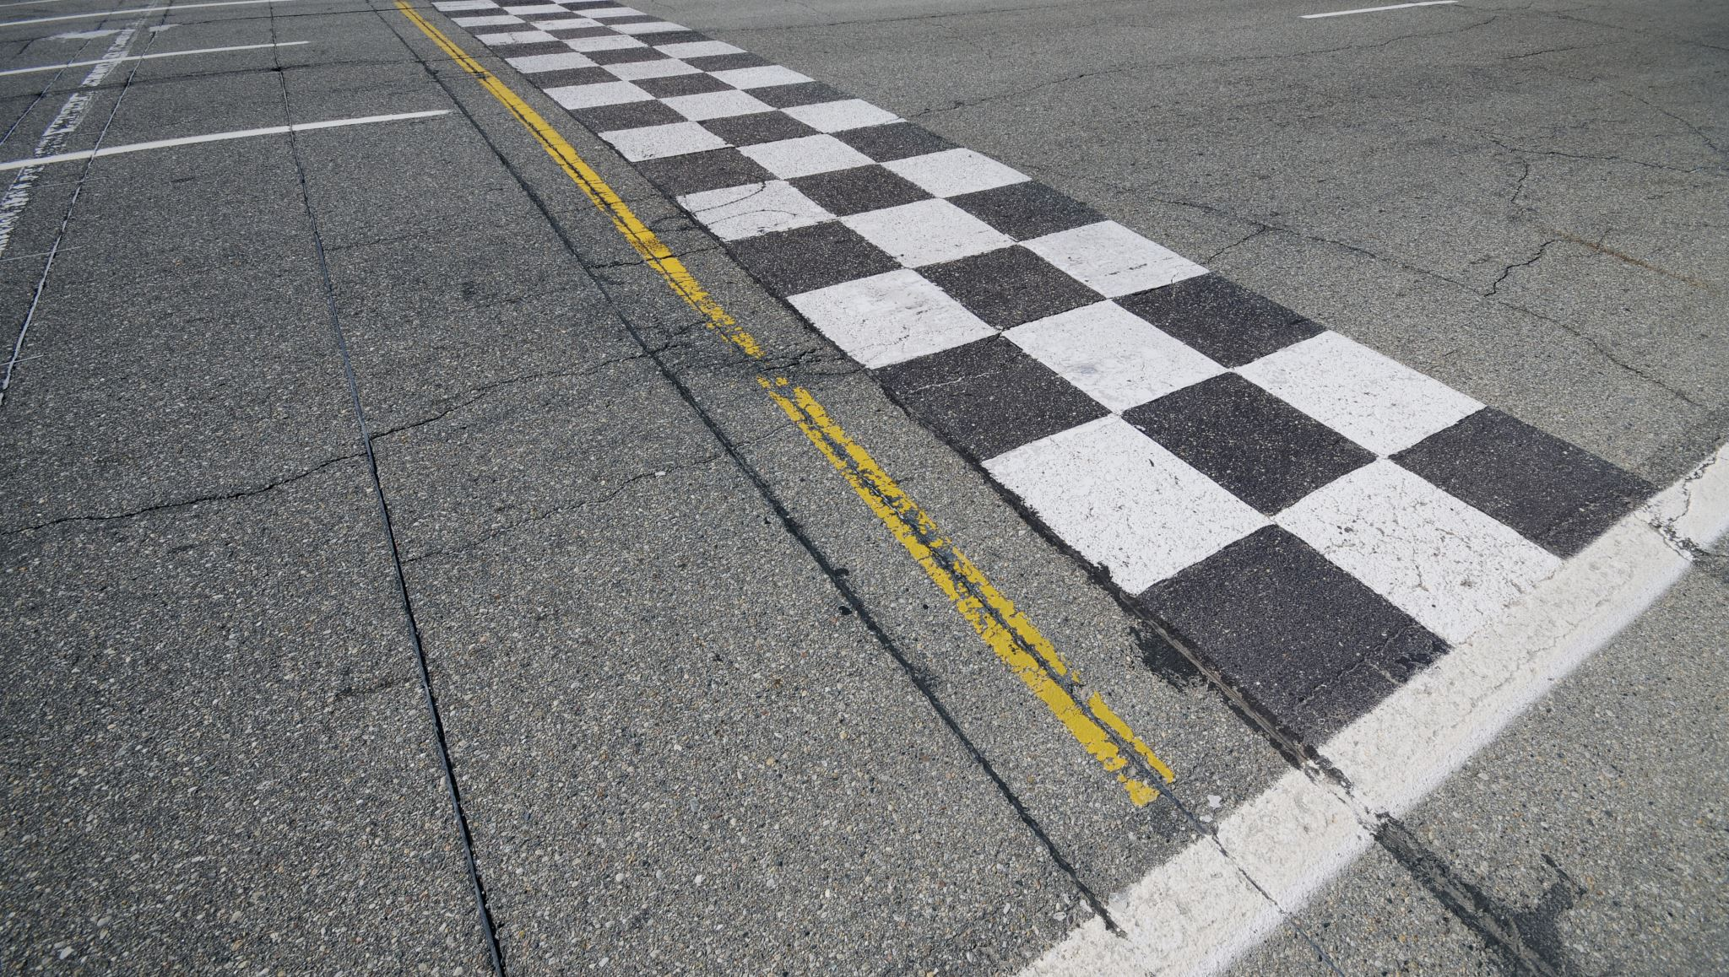



ROAD SURFACE ANOMALY DETECTION
TEAM MEMBERS
THANISORN SARAPHAN
PISUTTIPONG MEKDANG
PHAKORN TANTIRAPAN
TEAM: BADSBOYS

Slide 2

Idea
Apply Azure cognitive services to solve the fundamental issue (Road surface defect)
Using Anomaly detector API to detect the anomaly from mobile sensors
Using Custom vision to classify type of road surface anomaly.
Create prototype by incorporate Azure architecture as much as possible

Slide 3

Problem Statement
In Thailand, The defect on road surface has been a main issue for a long time. It effects to quality of life and may cause an accident.
Accessibility of the government to aware this issue is limited. Many factors are involved such as lack of channels for report the issue, lack of manpower for investigation and lack of data.
This project aims to applied Azure technology and create new tool to inspect and uncover the issues of road surface in Thailand to affiliate.

Slide 4
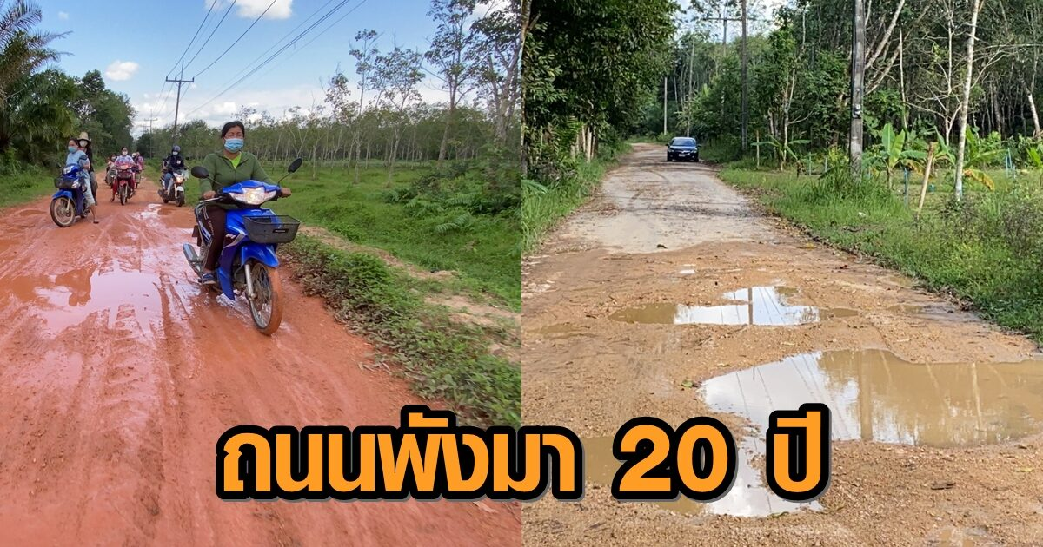
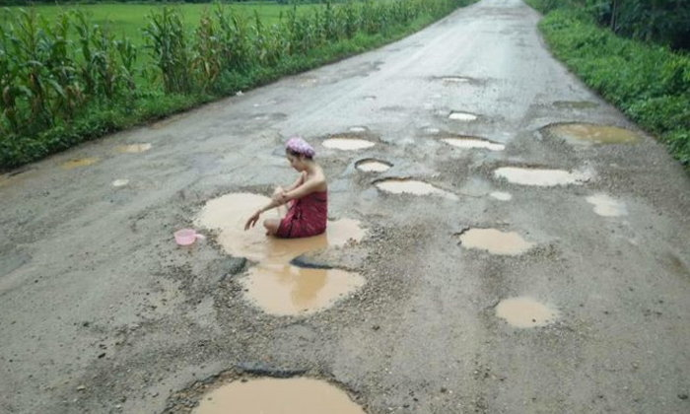
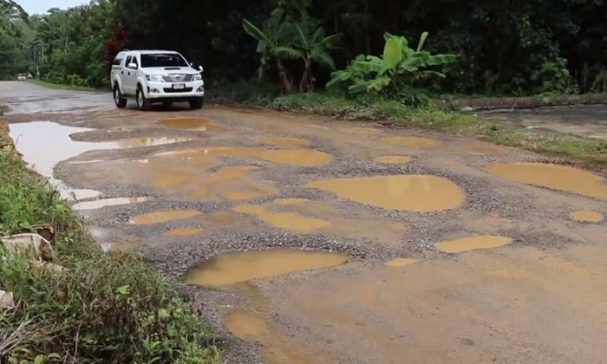
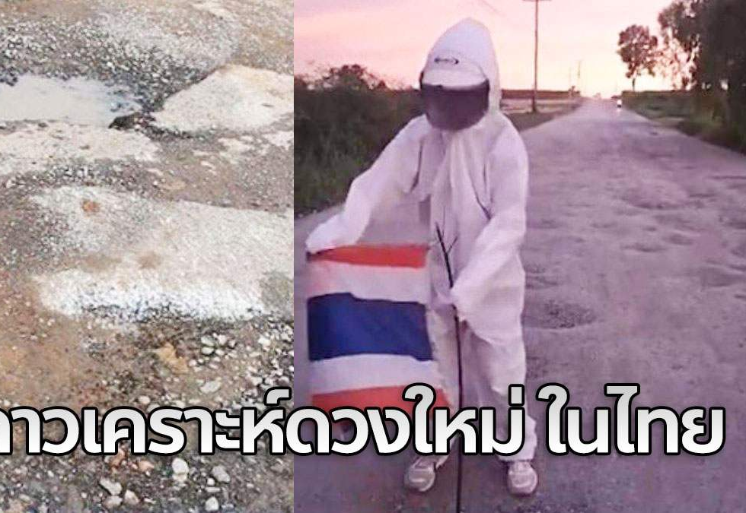
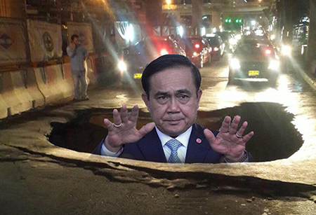
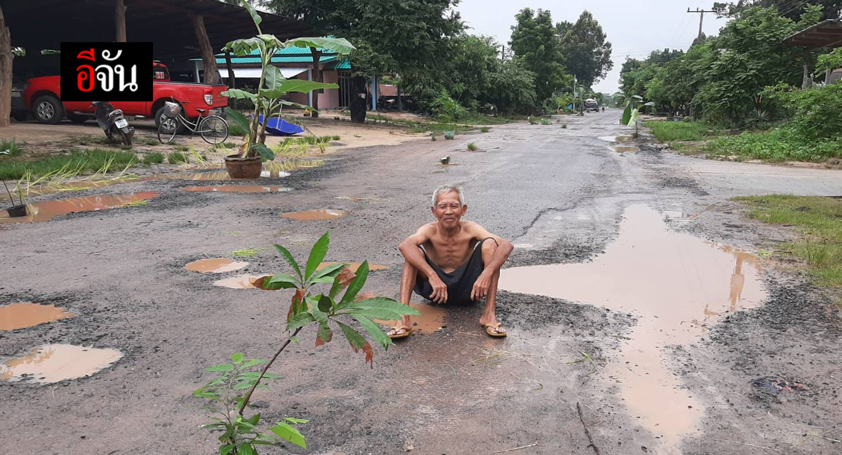
<ENG> Road has broken for 20 years
Peek - a - boo!
<ENG> New moon in Thailand

Slide 5





Approach
Training Anomaly detection
Power BI
Cloud storage blob
Azure Anomaly detector
Mobile sensor
Cloud storage blob
Azure custom vision
Model API
Azure synapse
Azure Anomaly detector
Model API
Training Image classification
Cloud storage blob
Azure custom vision

Slide 6
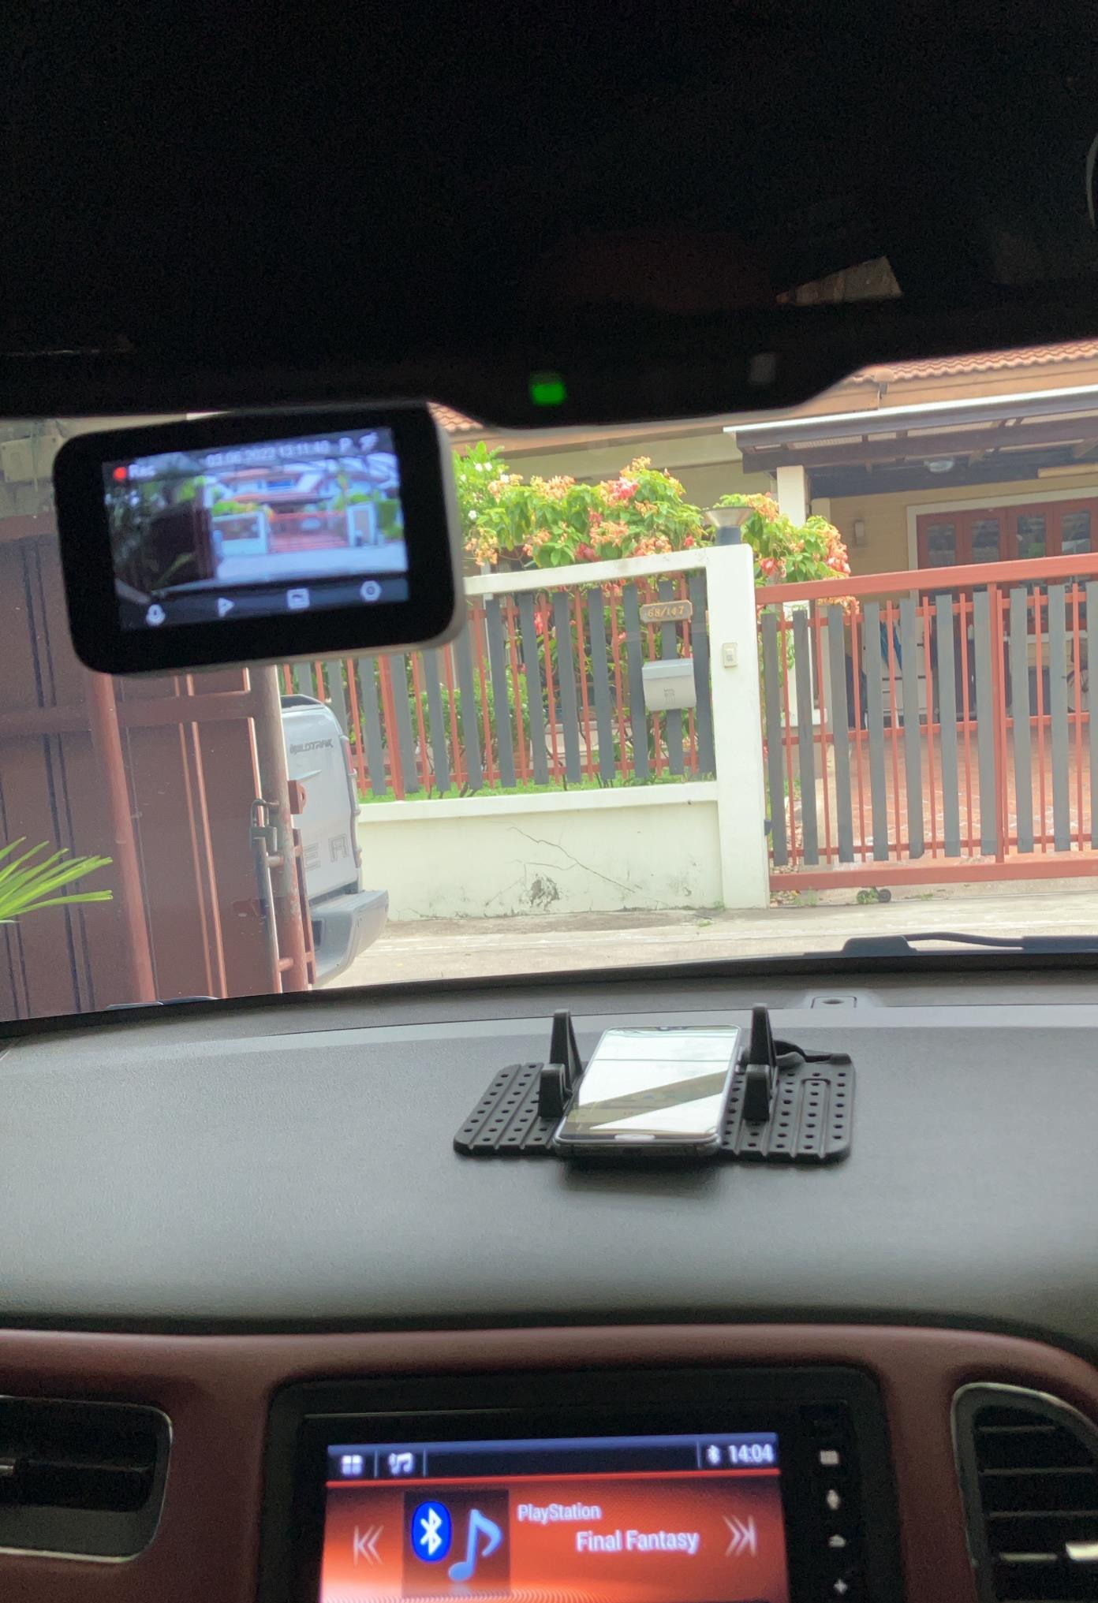

Data Collection
1. Mobile sensor we use Matlab mobile for collect sensor data.
Sensor consist of
Acceleration : X, Y, Z (m/s2)
Magnetic Field :X, Y, Z (µT)
Orientation : Azimuth, Pitch, Roll
Angular Velocity : X, Y, Z (rad/s)
Position : Latitude, Longitude, Speed, Course, Altitude, Horizontal Accuracy
Position of mobile we place it at the console and the top of mobile point to front side of the car and we use mobile sensor for make classification model to 7 category of anomaly road surface (Pothole, Manhole, Speed Bump, Lateral Crack, Longitudinal Crack, Repaired and Bridge Expansion Joint). After model detect area of road anomaly and we have geography information (Latitude, Longitude) to create dashboard visualize area issue and ranking severity to repaired.
2. Video camera for collect data of road condition, We need to feed more information to Government agencies e.g. snap shot image of road condition that it matching in same time of anomaly detected. We convert video to image file and use custom vision to train model.
Video Camera

Slide 7
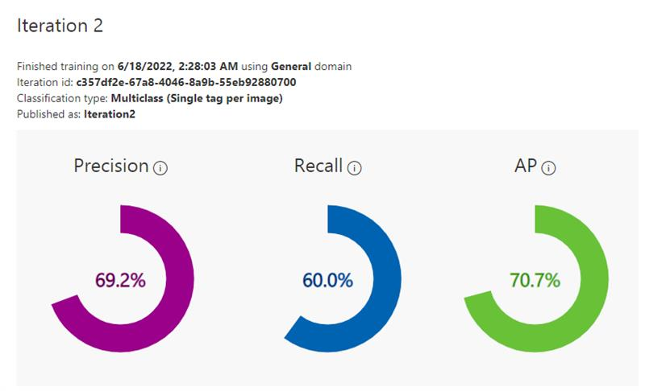
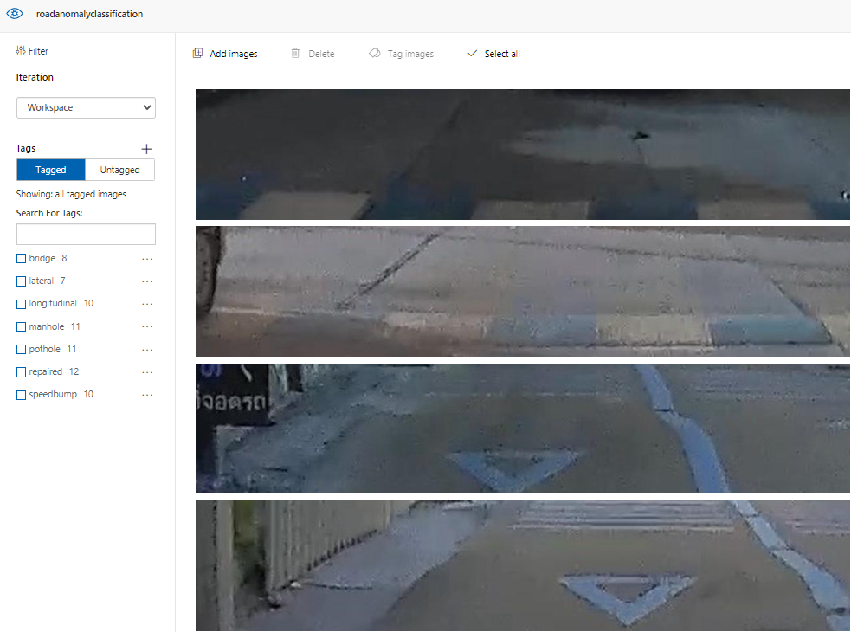
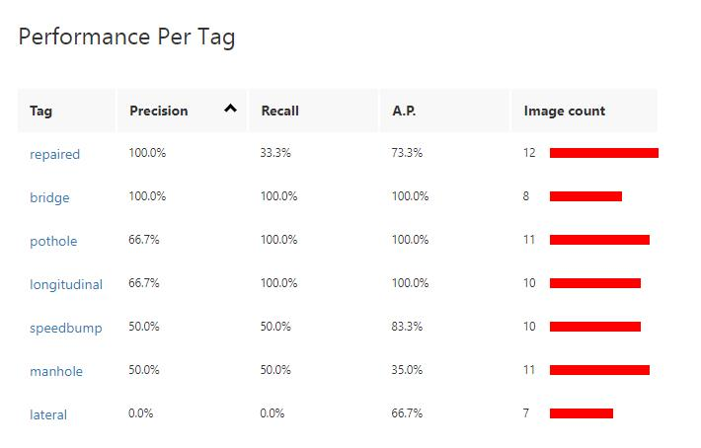
Custom Vision

Slide 8
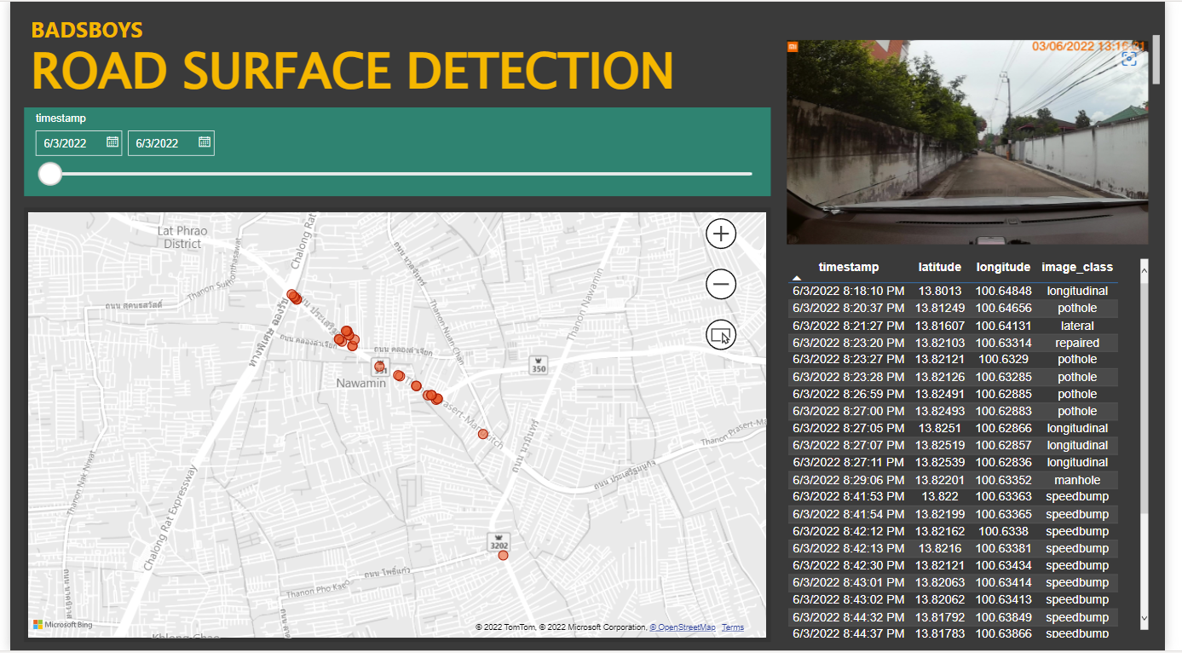
Visualization
We use Power BI to visualize our model's result by create interactive dashboard.
This dashboard could show the position on the map where the road surface have defect. It is including the classes of that defect.
User can click to show the picture of the road that stored in the Azure blob storage

Slide 9
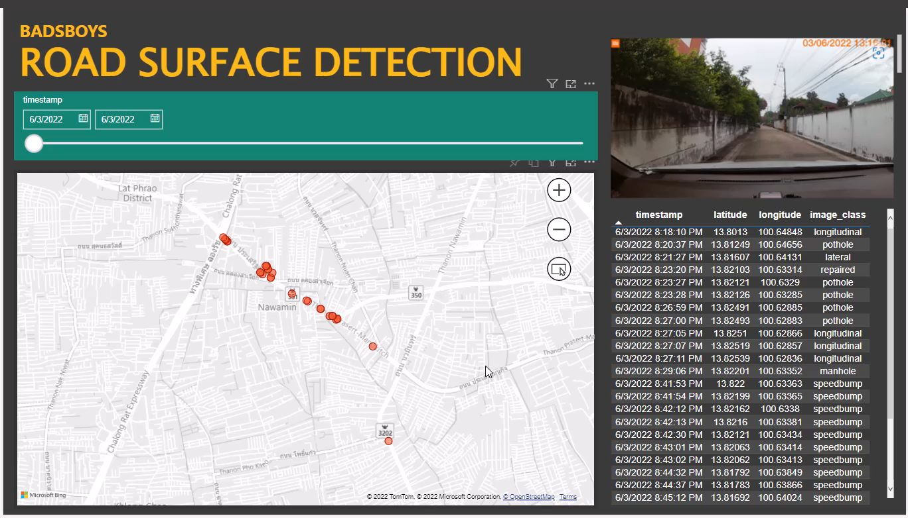
Prototype
Power BI dashboard: https://app.powerbi.com/groups/95c4e5e5-909e-486f-9d01-69a43dbc85ce/reports/9df3468b-9016-4bea-b265-5bf0e3501dff?ctid=db5def6b-8fd8-4a3e-91dc-8db2501a6822&pbi_source=linkShare
Git hub: https://github.com/bossthanison/ROAD-SURFACE-ANOMALY-DETECTION
See the video

